Slide 1
Exception Management - SAP BN × Aera
Concept & Prototype
Charleen Liu · April 2026
Prototype: https://charleen-liu.github.io/scm-exception-prototype/SBN_home.html

Slide 2
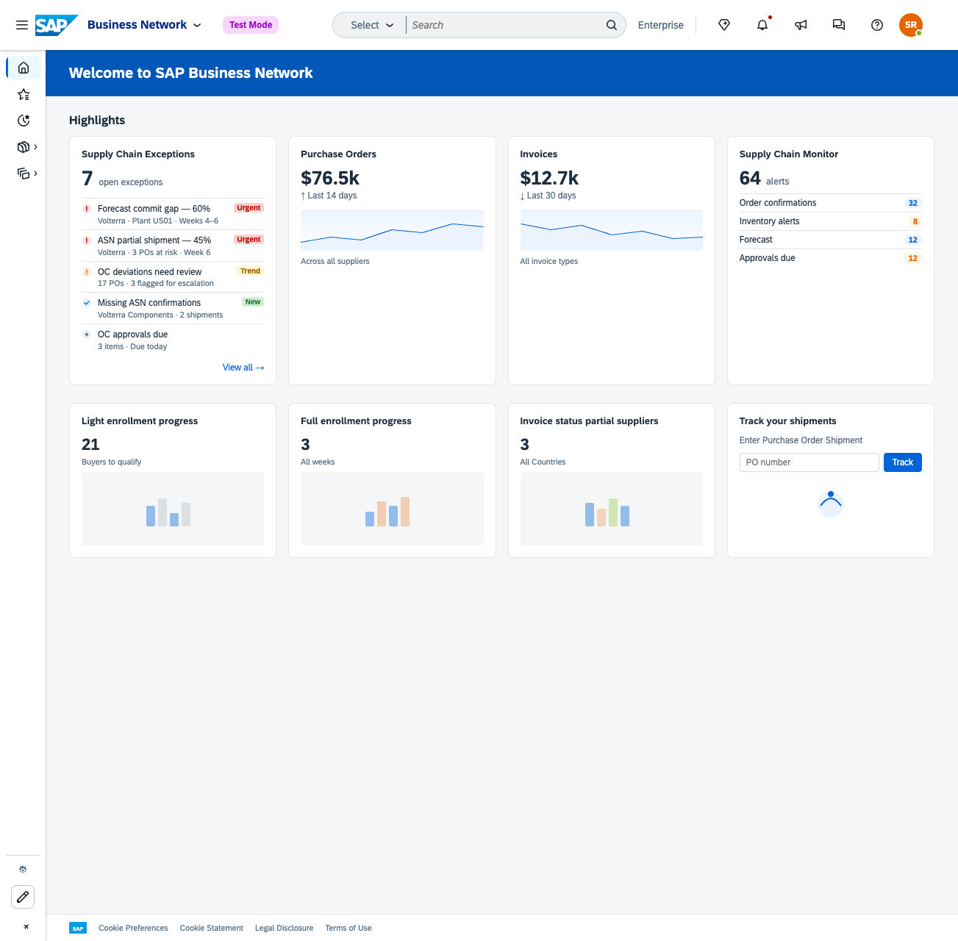
SBN Home
Supply Chain Exceptions Card
The SBN homepage surfaces active exceptions at a glance, giving buyers immediate visibility without navigating away from their daily workflow.
SC Exceptions card shows live exception count, urgency signal, and top supplier at risk
Drill into any exception for full detail, or tap View All to open the Exception Inbox

Slide 3
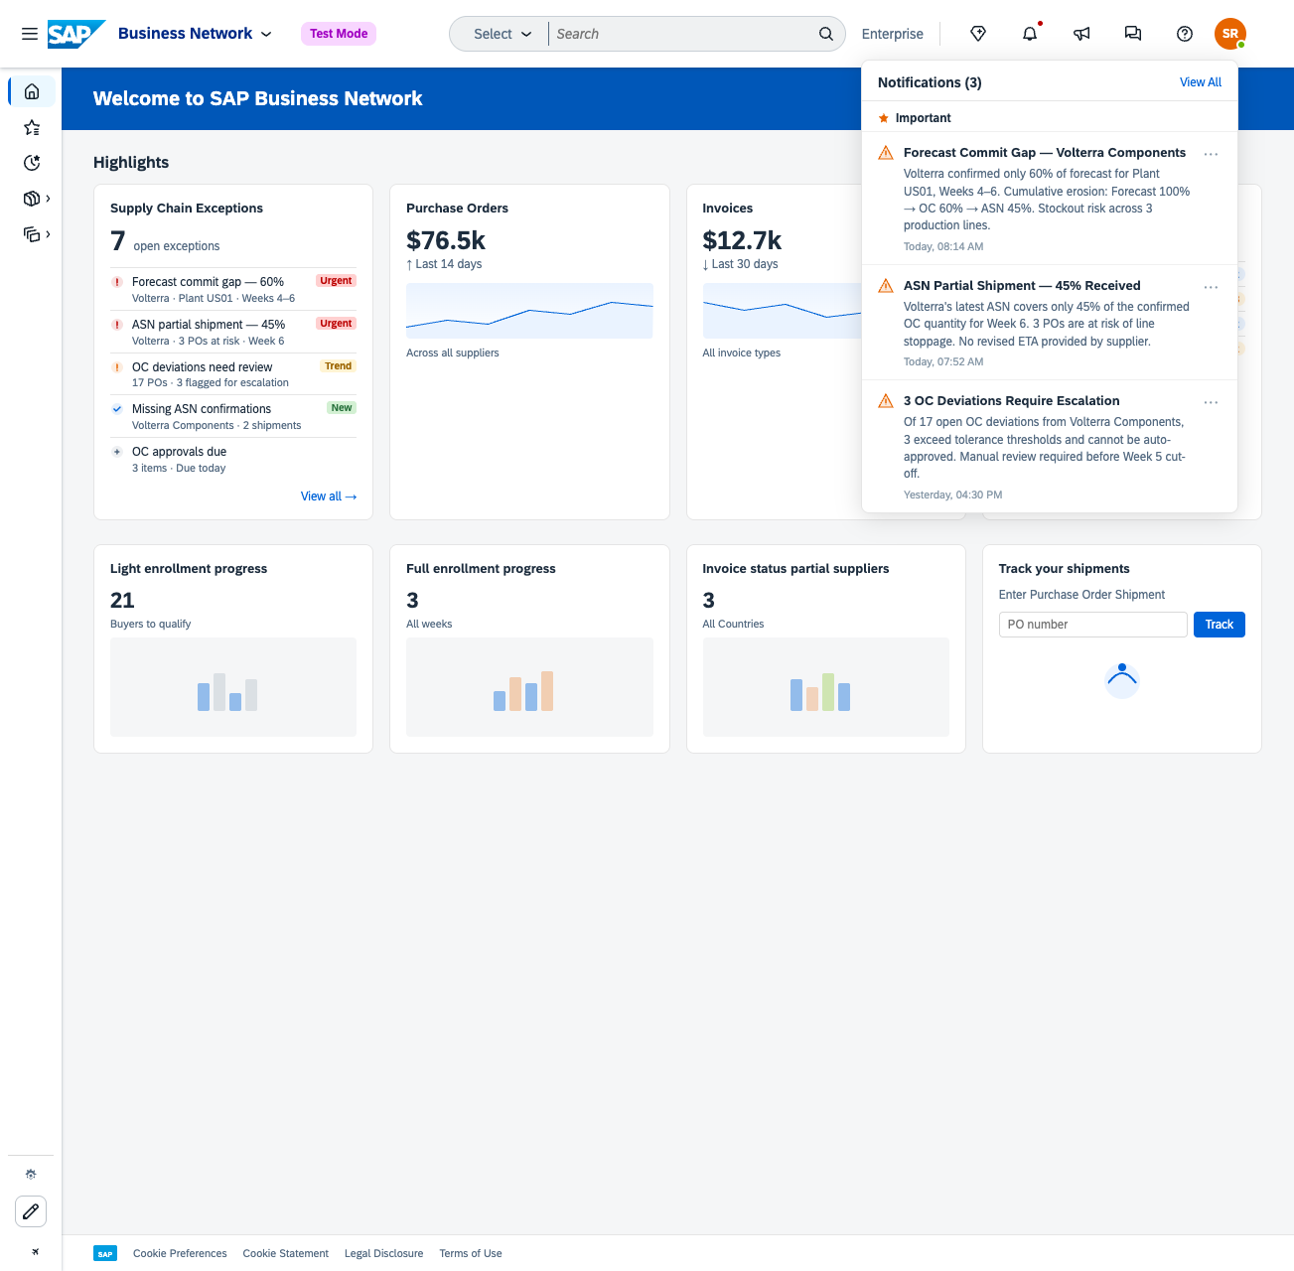
SBN Home: Notifications
Buyers are notified of new and escalating exceptions in real time via the notification bell — no polling, no manual triage.

Slide 4
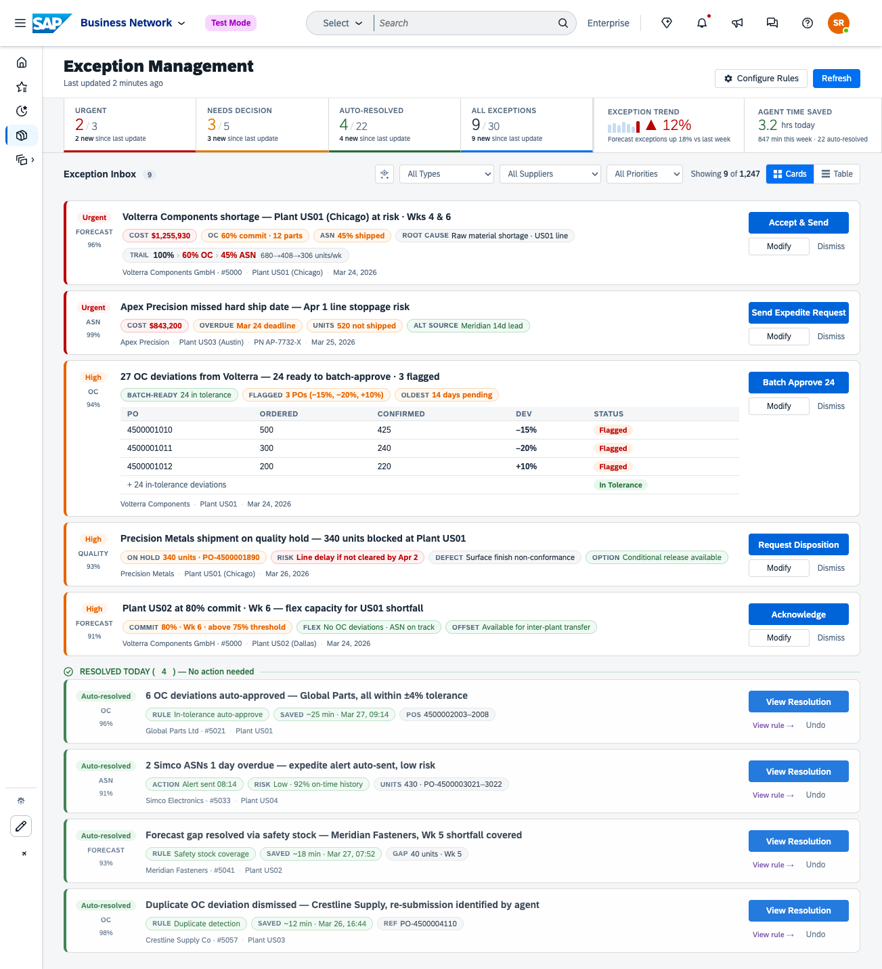
Exception Inbox - Overview
A single, intelligent workspace for all supply chain exceptions — triaged, prioritized, and partially resolved before the buyer arrives.
KPI strip shows Urgent / Needs Decision / Auto-Resolved counts at a glance
Aera-recommended actions surface inline — buyers can Act, Modify, or Dismiss without leaving the inbox
Auto-resolved exceptions are grouped below with time saved, giving buyers full visibility and auditability
"View rule →" on each auto-resolved card links directly to the Aera skill that triggered the resolution, closing the loop between operational view and admin configuration

Slide 5
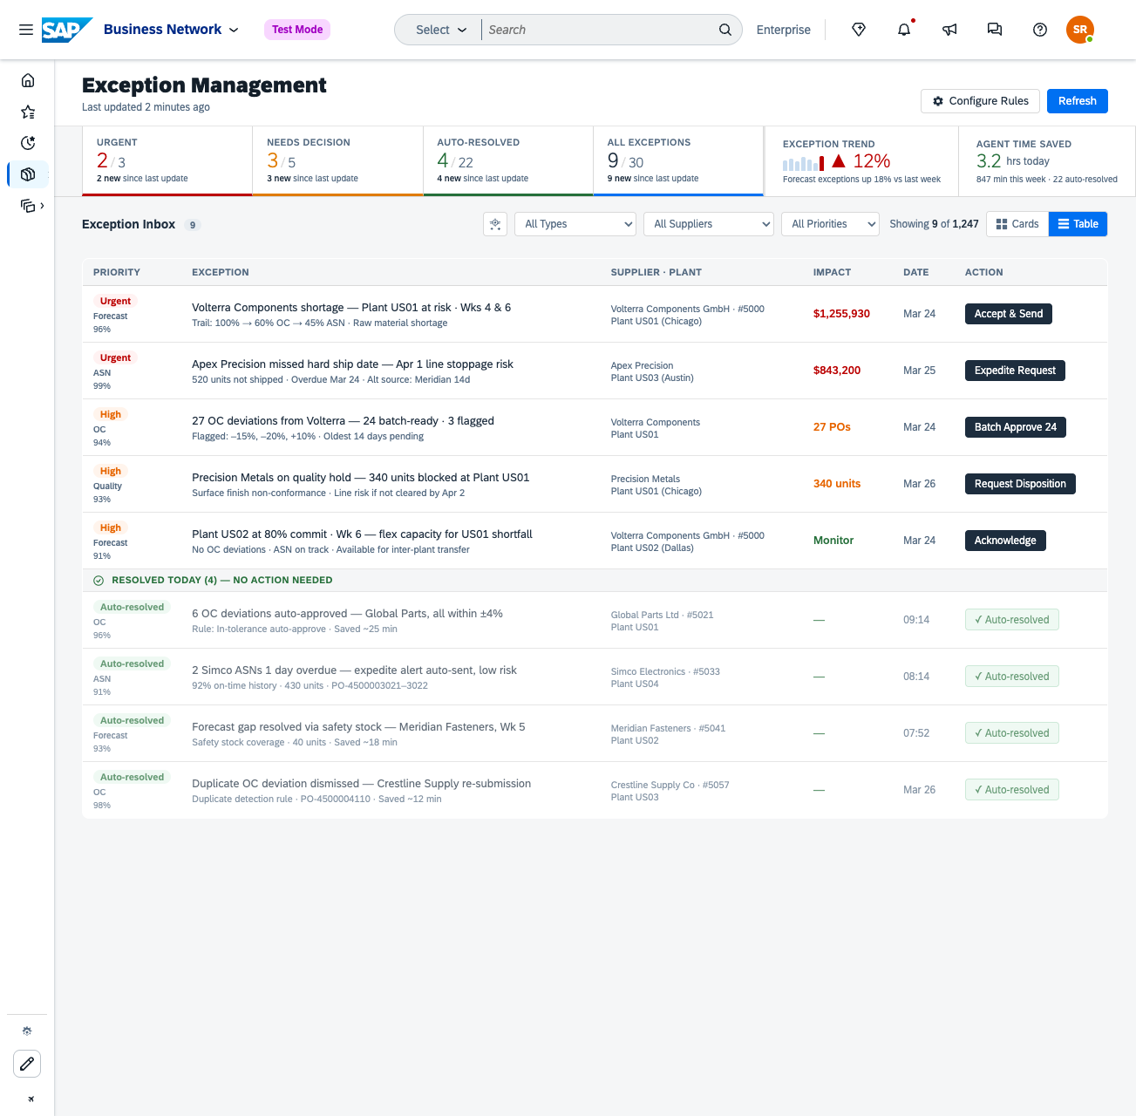
Exception Inbox: Views
Card view — rich per-exception KPIs, recommended actions, and signal chips optimized for decision-making
Table view — high-density layout for buyers managing large exception volumes or doing bulk triage

Slide 6
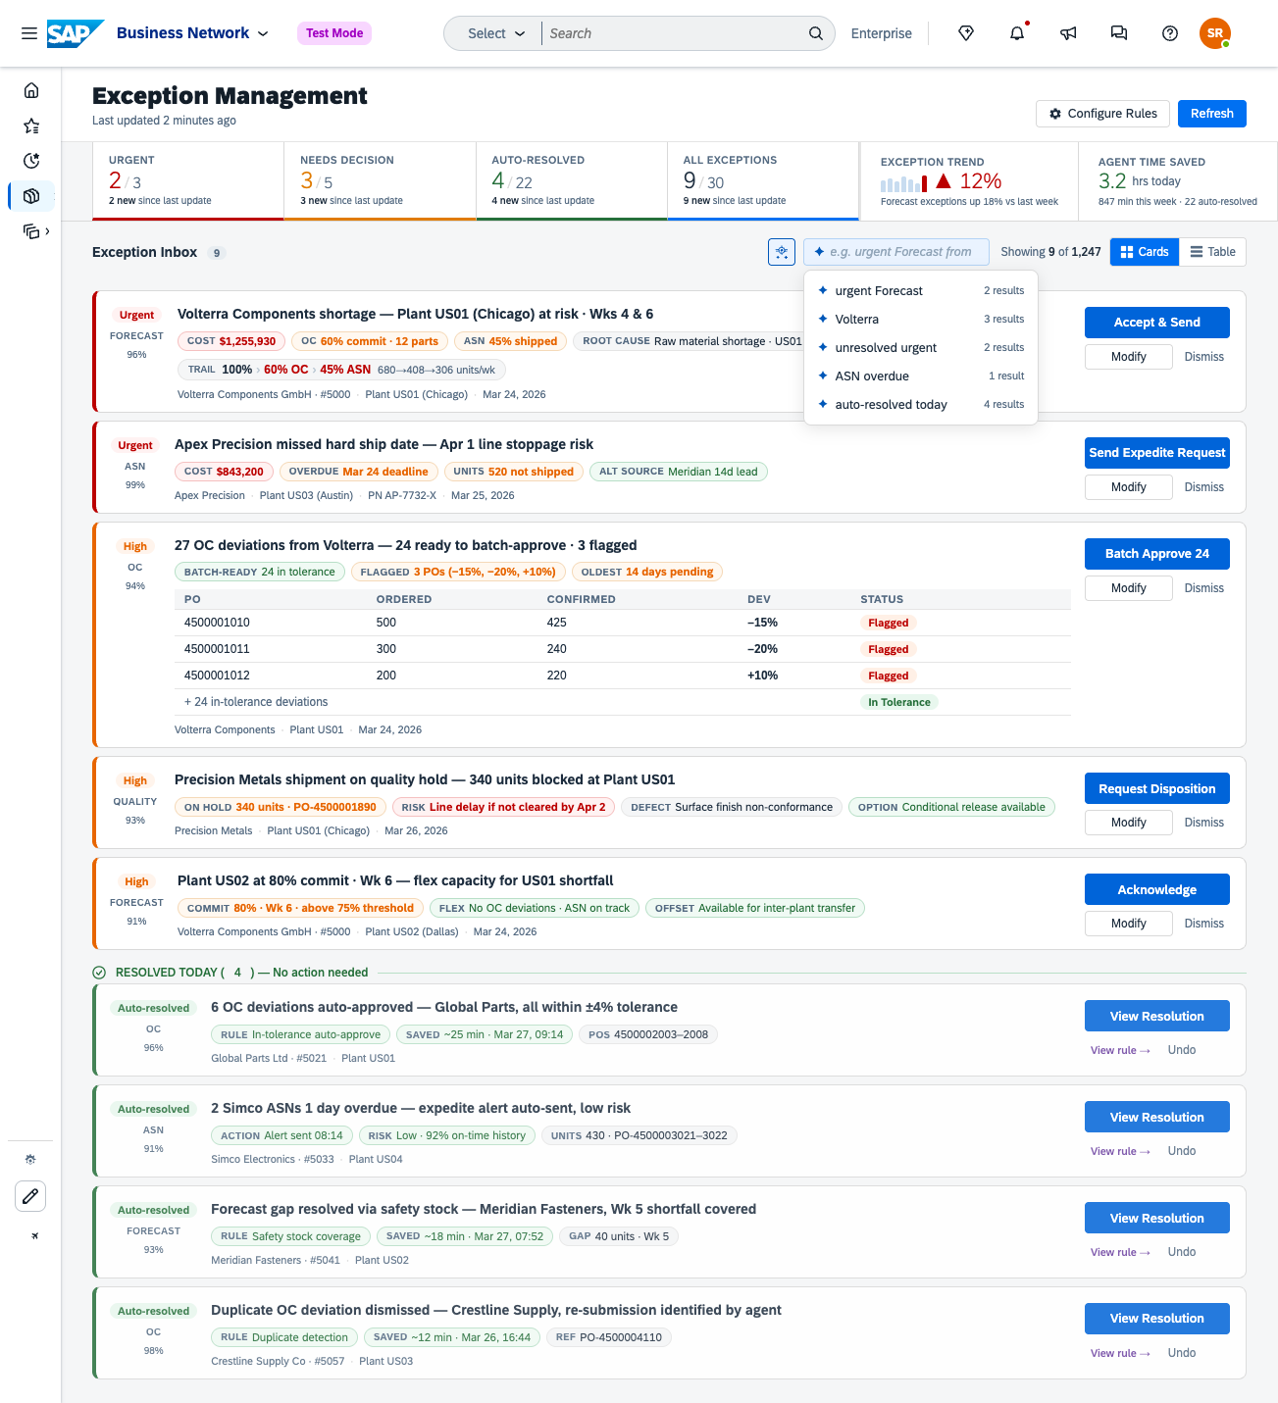
Exception Inbox: Intelligent Filter
Natural Language Filtering
Buyers can filter the exception inbox using plain language — no dropdowns, no manual query building.
Example: "Show urgent forecast exceptions for Volterra this week"

Slide 7
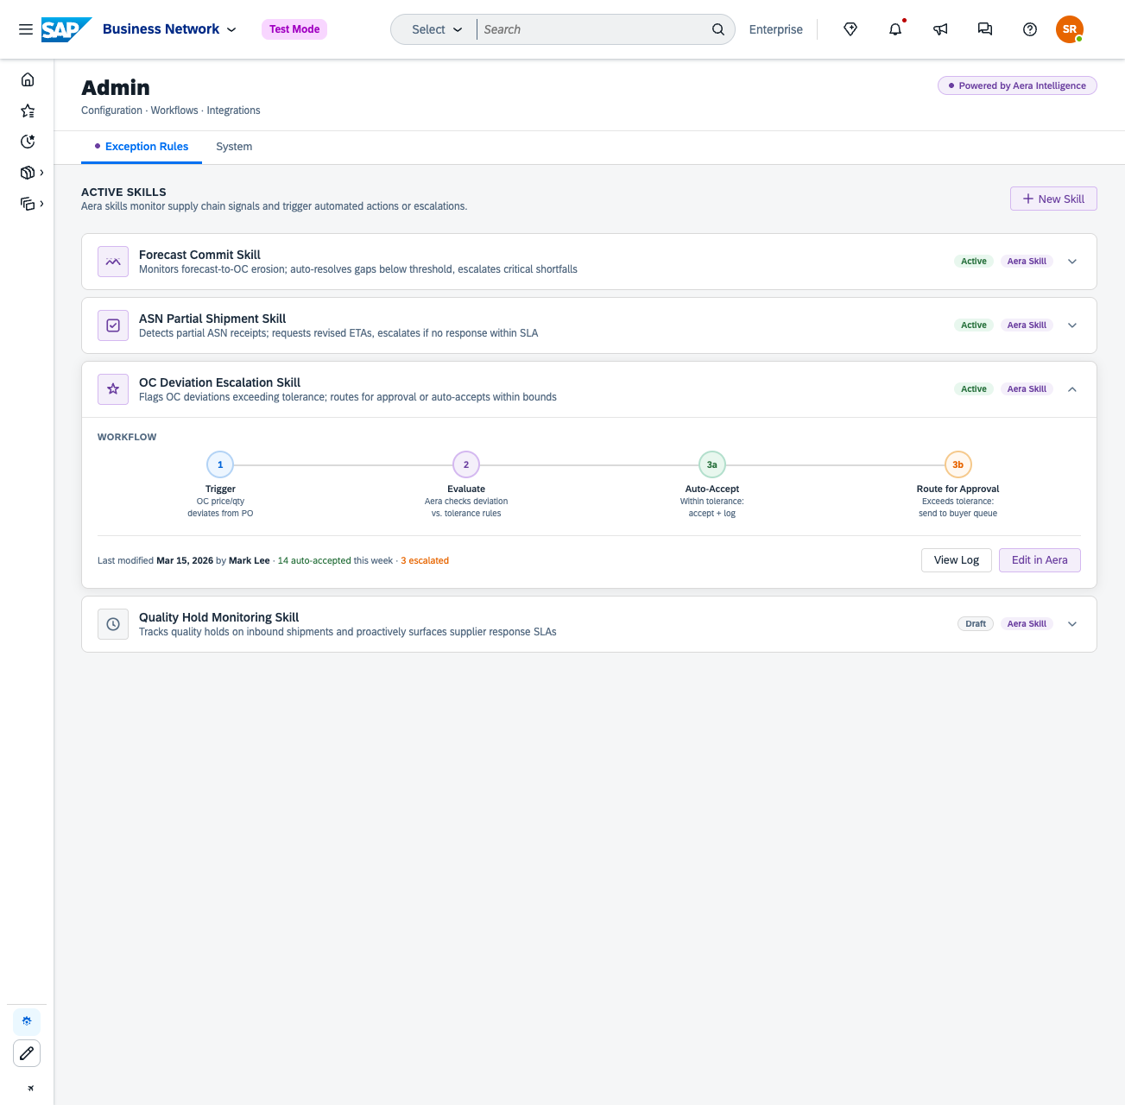
Admin: Exception Rules (Aera layer)
Admin - Configure Exception Rules
Aera owns the intelligence layer:
Skill configuration — define what triggers an exception and what action to take
Auto-resolve thresholds, escalation chains, and approval workflows
Active skills in prototype: Forecast Commit, ASN Partial Shipment, OC Deviation Escalation
Each skill shows trigger → evaluate → auto-resolve/escalate workflow steps with a live threshold slider
"Powered by Aera" badge marks the boundary clearly for both users and partners

Slide 8
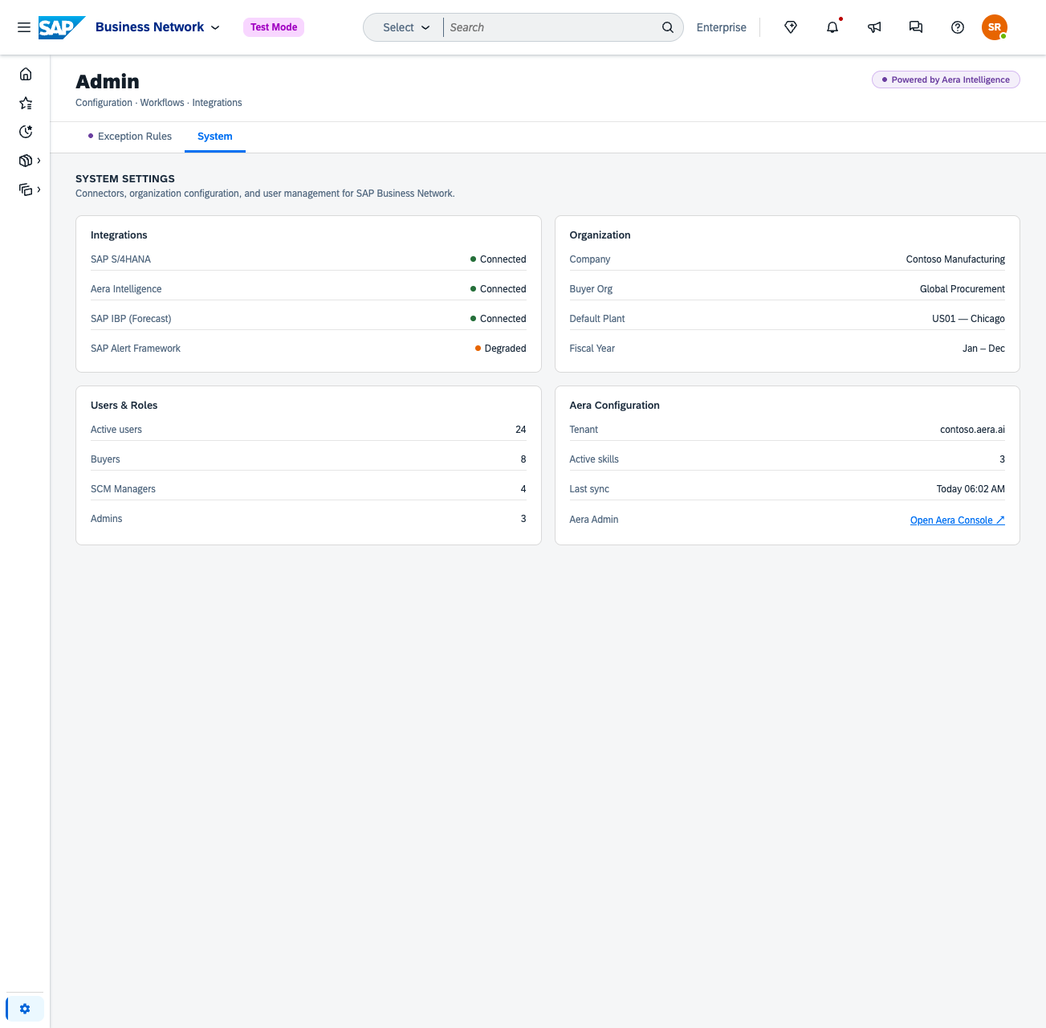
Admin: System Settings (BN layer)
Admin – System settings
SAP BN owns the operational layer:
System connectors (S/4HANA, SAP IBP, Alert Framework)
Organization structure, plant configuration, fiscal year
User roles and access
The convergence model presents one unified Admin experience — Aera configures the intelligence, BN owns the data and operations. No context switching for the user

Slide 9
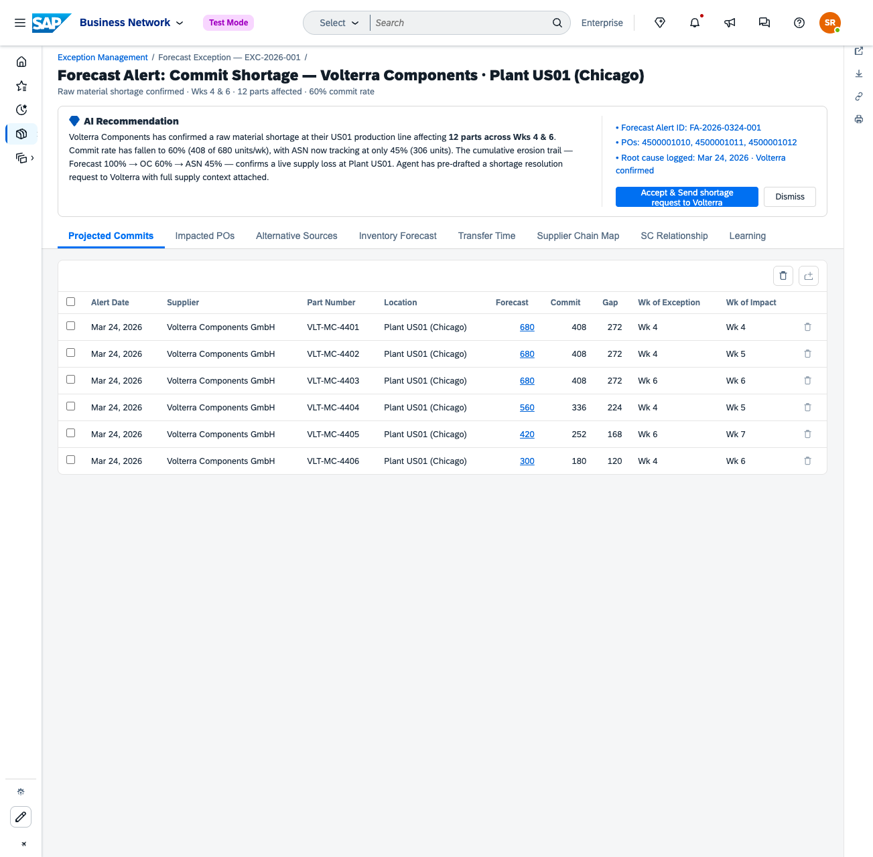
Exception Details
Exception Details – powered by Aera
Full analysis for a single exception, surfaced in context.
Root cause breakdown with contributing signals (Forecast erosion, OC gap, ASN shortfall)
Aera-recommended action with confidence score and reasoning
Deep linking — navigate directly from the exception into the relevant BN application (e.g. click the Forecast figure to open the Forecast detail view in context)

Slide 10
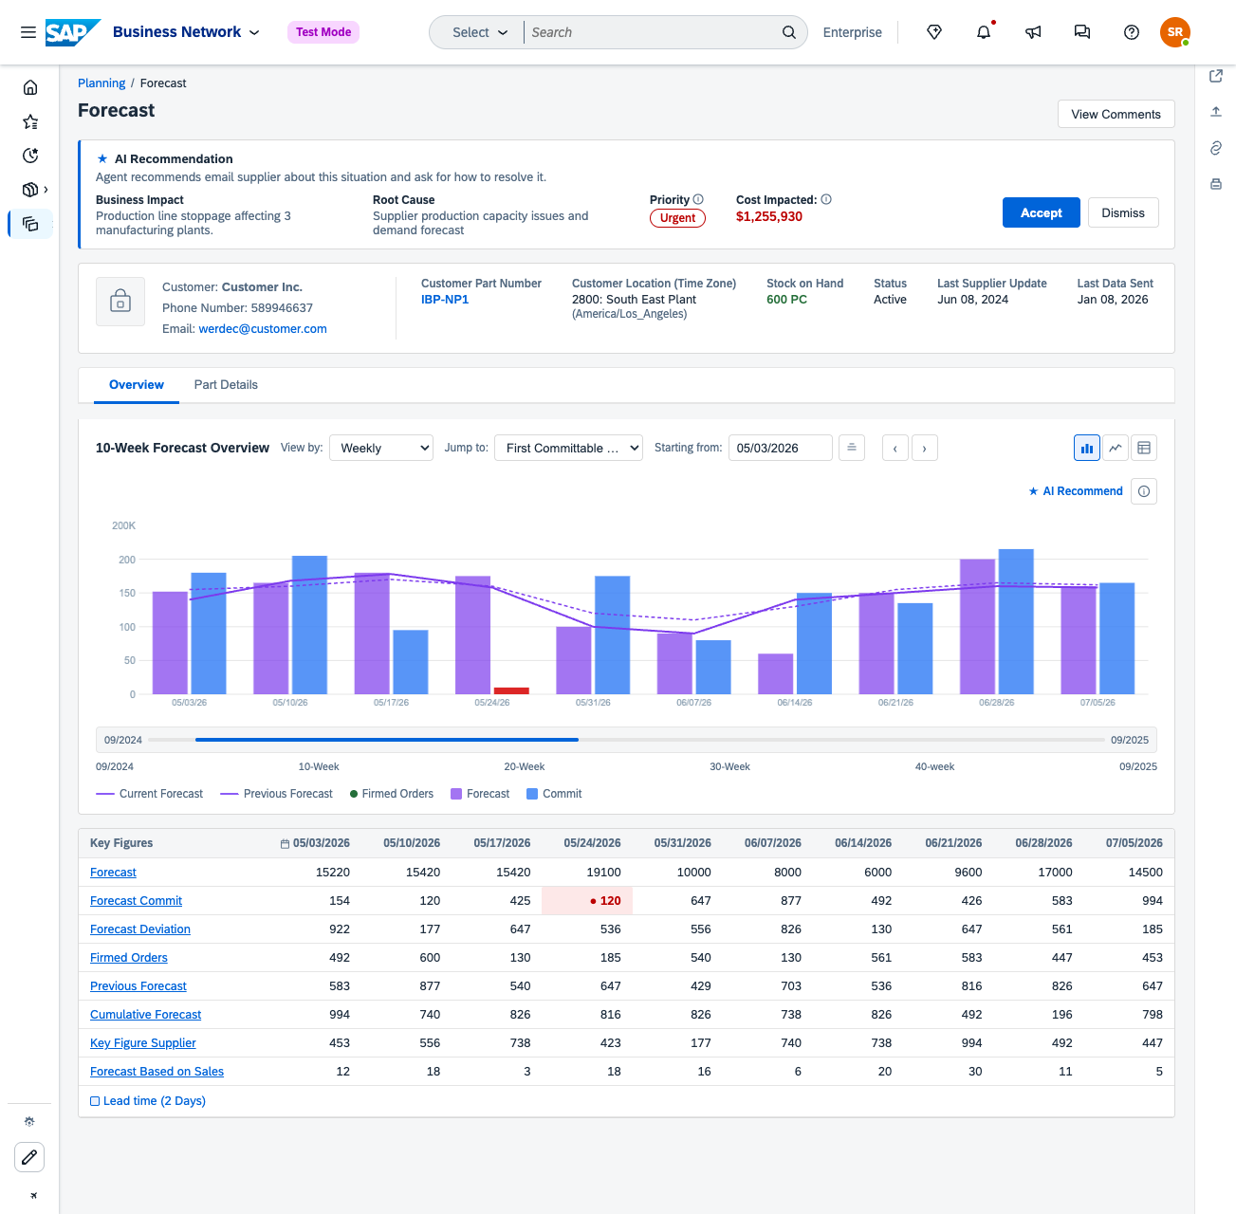
Deep Linking & Recommended Action
The prototype demonstrates an end-to-end loop:
Exception surfaces in the Inbox (SAP BN)
Aera provides root cause + recommended action
Deep link opens the source document in context (e.g. Forecast)
Buyer acts — or Aera has already resolved it
Admin shows which skill drove the resolution, and allows threshold tuning

